Slide 1
Machine Learning
Chapter 1
Introduction

Slide 2
COURSE OBJECTIVES
To formulate machine learning problems corresponding to an application.
COURSE OUTCOMES
1 Explain the basics of concept learning and inductive learning.
2 Design decision tree and neural network to solve classification problems.
3 Comprehend probabilistic methods for learning.
4 Explain the instance based learning and reinforcement learning.
5 Build optimal classifiers using Genetic Algorithm and deep learning.
Learning Resources:
Tom Mitchell, ―Machine Learning‖, McGraw-Hill Science, First edition.

Slide 3
Unit-I
Introduction: Well-Posed Learning Problems, Designing a Learning System, Issues in Machine Learning.
The Concept Learning: A concept Learning Task, General –to- Specific Ordering of Hypothesis, Find-S, The List-Then-Eliminate Algorithm, Candidate Elimination Learning Algorithm, Inductive bias.

Slide 4
Introduction
The field of machine learning is concerned with the question of how to construct computer programs that automatically improve with experience. In recent years many successful machine learning applications have been developed, ranging from data-mining programs that learn to detect fraudulent credit card transactions, to information-filtering systems that learn users' reading preferences, to autonomous vehicles that learn to drive on public highways. At the same time, there have been important advances in the theory and algorithms that form the foundations of this field.
Machine learning draws on concepts and results from many fields, including statistics, artificial intelligence, philosophy, information theory, biology, cognitive science, computational complexity, and control theory

Slide 5
Introduction
A subfield of Computer Science that gives computers the ability to learn without being explicitly programmed.
To improve automatically with experience.
For Example: Imagine computers learning from medical records which treatments are most effective for new disease.

Slide 6
houses learning from experience to optimize energy costs based on the particular usage patterns of their occupants,
personal software assistants learning the evolving interests of their users in order to highlight especially relevant stories from the online morning newspaper
Algorithms have been invented that are effective for certain types of learning tasks, and a theoretical understanding of learning is beginning to emerge.
For problems such as speech recognition, algorithms based on machine learning outperform all other approaches that have been attempted to date.
In data mining, machine learning algorithms are being used routinely to discover valuable knowledge from large commercial databases containing equipment maintenance records, loan applications, financial transactions, medical records,

Slide 7
Programs have been developed that successfully learn to recognize spoken words(Waibel 1989; Lee 1989),
predict recovery rates of pneumonia patients (Cooperet al. 1997),
detect fraudulent use of credit cards,
drive autonomous vehicles on public highways (Pomerleau 1989),
play games such as backgammon at levels approaching the performance of human world champions (Tesauro 1992, 1995).
Machine learning is inherently a multidisciplinary field. It draws on results from artificial intelligence, probability and statistics, computational complexity theory, control theory, information theory, philosophy, psychology, neurobiology, and other fields.

Slide 8
Well-Posed Learning Problems
Definition: A computer program is said to learn from experience E with respect to some class of tasks T and performance measure P, if its performance at tasks in T, as measured by P, improves with experience E.
Ex : A computer program that learns to play checkers might improve its performance as measured by its abiliry to win at the class of tasks involving playing checkers games, through experience obtained by playing games against itself.

Slide 9
Applications of Machine Learning
Learning to recognize spoken words: For example, the SPHINX system (e.g., Lee 1989) learns speaker-specific strategies for recognizing the primitive sounds (phonemes) and words from the observed speech signal. Neural network learning methods (e.g., Waibel et al. 1989) and methods for learning hidden Markov models (e.g., Lee 1989) are effective for automatically customizing to,individual speakers, vocabularies, microphone characteristics, background noise, etc.
Learning to drive an autonomous vehicle: Machine learning methods have been used to train computer-controlled vehicles to steer correctly when driving on a variety of road types. For example, the ALVINN system has used its learned strategies to drive unassisted at 70 miles per hour for 90 miles on public highways among other cars

Slide 10
Learning to classify new astronomical structures: Machine learning methods have been applied to a variety of large databases to learn general regularities implicit in the data.
For example, decision tree learning algorithms have been used by NASA to learn how to classify celestial objects from the second Palomar Observatory Sky Survey.
Learning to play world-class backgammon: The most successful computer programs for playing games such as backgammon are based on machiie learning algorithms
For example, the world's top computer program for backgammon, TD-GAMMON (Tesauro 1992, 1995). learned its strategy by playing over one million practice games against itself. al. 1995)

Slide 11
What is the Learning Problem?
Three features in Learning Problem:
  The class of tasks(T),
  The measure of performance to be improved(P), and
  The source of experience(E ).

Slide 12
Examples of Learning Problem
Example Problem 1
A checkers learning problem:
Task T: playing checkers
Performance measure P: percent of games won against opponents
Training experience E: playing practice games against itself

Slide 13
Example Problem 2
A handwriting recognition learning problem
Task T: recognizing and classifying handwritten words within images
Performance measure P: percent of words correctly classified
Training experience E: a database of handwritten words with given classifications

Slide 14
Example Problem 3
A robot driving learning problem:
Task T: driving on public four-lane highways using vision sensors
Performance measure P: average distance traveled before an error (as judged by human overseer)
Training experience E: a sequence of images and steering commands recorded while observing a human driver

Slide 15
Disciplines and Examples of their influence on Machine Learning
Artificial intelligence - Learning symbolic representations of concepts. Machine learning as a search problem. Learning as an approach to improving problem solving. Using prior knowledge together with training data to guide learning.
Bayesian methods - Bayes' theorem as the basis for calculating probabilities of hypotheses. The naive Bayes classifier. Algorithms for estimating values of unobserved variables.
Computational complexity theory- Theoretical bounds on the inherent complexity of different learning tasks, measured in terms of the computational effort, number of training examples, number of mistakes, etc. required in order to learn.

Slide 16
Control theory -Procedures that learn to control processes in order to optimize predefined objectives and that learn to predict the next state of the process they are controlling.
Information theory - Measures of entropy and information content. Minimum description length approaches to learning. Optimal codes and their relationship to optimal training sequences for encoding a hypothesis.
Philosophy - Occam's razor, suggesting that the simplest hypothesis is the best. Analysis of the justification for generalizing beyond observed data.
Psychology and neurobiology -The power law of practice, which states that over a very broad range of learning problems, people's response time improves with practice according to a power law.
Statistics - Characterization of errors (e.g., bias and variance) that occur when estimating the accuracy of a hypothesis based on a limited sample of data.

Slide 17
DESIGNING A LEARNING SYSTEM
Choosing the Training Experience
Choosing the Target Function
Choosing a Representation for the Target Function
Choosing a Function Approximation Algorithm
The Final Design

Slide 18
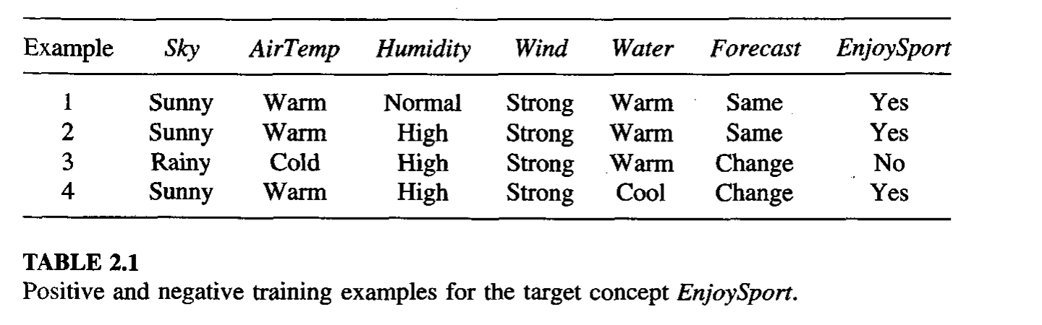

Training Examples

Slide 19
Choosing the Training Experience
Choose the type of training experience from which our system will learn. The type of training experience available can have asignificant impact on success or failure of the learner
Type of training experience- One key attribute is whether the training experience provides direct or indirect feedback regarding the choices made by the performance system.
In learning to play checkers, the system might learn from direct training examples consisting of individual checkers board states and the correct move for each. Alternatively, it might have available only indirect information consisting of the move sequences and final outcomes of various games played

Slide 20
Information about the correctness of specific moves early in the game must be inferred indirectly from the fact that the game was eventually won or lost. Here the learner faces an additional problem of credit assignment, or determining the degree to which each move in the sequence deserves credit or blame for the final outcome. Credit assignment can be a particularly difficult problem because the game can be lost even when early moves are optimal, if these are followed later by poor moves. Hence, learning from direct training feedback is typically easier than learning from indirect feedback

Slide 21
A second important attribute of the training experience is the degree to which the learner controls the sequence of training examples.
For example, the learner might rely on the teacher to select informative board states and to provide the correct move for each. Alternatively, the learner might itself propose board states that it finds particularly confusing and ask the teacher for the correct move. Or the learner may have complete control over both the board states and (indirect) training classifications, as it does when it learns by playing against itself with no teacher present. learner may choose between experimenting with novel board states that it has not yet considered, or honing its skill by playing minor variations of lines of play it currently finds most promising.
.

Slide 22
training experience is provided by a random process outside the learner's control, settings in which the learner may pose various types of queries to an expert teacher, and settings in which the learner collects training examples by autonomously exploring its environment.

Slide 23
A third important attribute of the training experience is how well it represents the distribution of examples over which the final system performance P must be measured.
Learning is most reliable when the training examples follow a distribution similar to that of future test examples
checkers learning scenario : the performance metric P is the percent of games the system wins in the world tournament. If its training experience E consists only of games played against itself, there is an obvious danger that this training experience might not be fully representative of the distribution of situations over which it will later be tested. the learner might never encounter certain crucial board states that are very likely to be played by the human checkers champion

Slide 24
Choosing the Training Experience
A checkers learning problem:
Task T: playing checkers
Performance measure P: percent of games won in the world tournament
Training experience E: games played against itself
In order to complete the design of the learning system, we must choose
the exact type of knowledge to be learned
a representation for this target knowledge
a learning mechanism

Slide 25
checkers-playing program that can generate the legal moves from any board state. The program needs only to learn how to choose the best move from among these legal moves. This learning task is representative of a large class of tasks for which the legal moves that define some large search space are known a priori, but for which the best search strategy is not known. Many optimization problems fall into this class, such as the problems of scheduling and controlling manufacturing processes where the available manufacturing steps are well understood, but the best strategy for sequencing them is not.

Slide 26
To determine what type of knowledge will be learned and how this will be used by the performance program is important
Example: In play checkers, it needs to learn to choose the best move from among these legal moves. ChooseMove : B -> M to indicate that this function accepts as input any board from the set of legal board states B and produces as output some move from the set of legal moves M.
An alternative target function for indirect training experience available is the one that will turn out to be easier to learn is an evaluation function that assigns a numerical score to any given board state
Target function V and again use the notation V : B -> R to denote that V maps any legal board state from the set B to some real value (we use R to denote the set of real numbers).

Slide 27
Choosing the Target Function
value of the target function V for any given board state is any evaluation function that assigns higher scores to better board states
Lets define the target value V(b) for an arbitrary board state b in B, as follows:
if b is a final board state that is won, then V(b) = 100
if b is a final board state that is lost, then V(b) = -100
if b is a final board state that is drawn, then V(b) = 0
if b is a not a final state in the game, then V(b) = V(b' ), where b' is the best final board state that can be achieved starting from b and playing optimally until the end of the game (assuming the opponent plays optimally, as well).

Slide 28
determining the value of V(b) for a particular board state requires (case 4) searching ahead for the optimal line of play, all the way to the end of the game! Because this definition is not efficiently computable by our checkers playing program, we say that it is a nonoperational definition. The goal of learning in this case is to discover an operational description of V ; that is, a description that can be used by the checkers-playing program to evaluate states and select moves within realistic time bounds.
learning task is the problem of discovering an operational description of the ideal target function V.

Slide 29
Choosing a Representation for the Target Function
let us choose a simple representation: for any given board state, the function c will be calculated as a linear combination of the following board features:
xl: the number of black pieces on the board
x2: the number of red pieces on the board
x3: the number of black kings on the board
x4: the number of red kings on the board
x5: the number of black pieces threatened by red (i.e., which can be captured on red's next turn)
X6: the number of red pieces threatened by black

Slide 30
Thus, our learning program will represent V(b) as a linear function of the form
where W0 through W6 are numerical coefficients, or weights, to be chosen by the learning algorithm
Learned values for the weights wl through W6 will determine the relative importance of the various board features in determining the value of the board, whereas the weight wo will provide an additive constant to the board value.

Slide 31
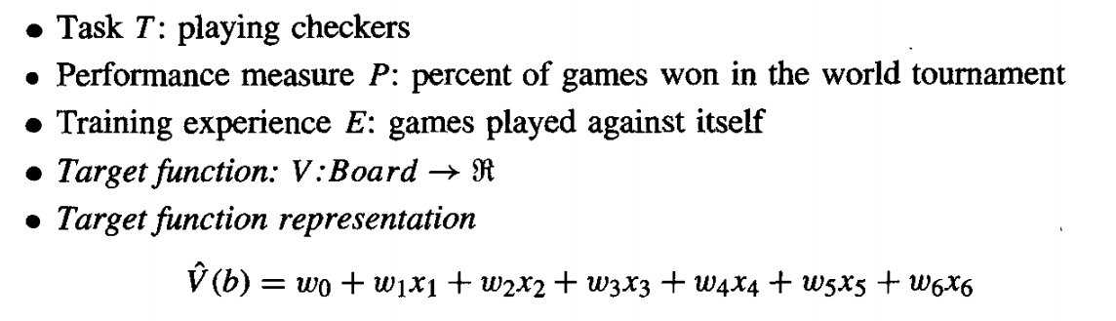
Partial design of a checkers learning program:

Slide 32
Choosing a Function Approximation Algorithm
In order to learn the target function f , a set of training examples reuired , each describing a specific board state b and the training value Vtrain(b) for b.
Each training example is given by <b, Vtrain(b)> where Vtrain(b) is training value for b.
Example: black has won the game(x2=0)

Slide 33
ESTIMATING TRAINING VALUES
only training information available to our learner is whether the game was eventually won or lost. On the other hand, we require training examples that assign specific scores to specific board states. While it is easy to assign a value to board states that correspond to the end of the game, it is less obvious how to assign training values to the more numerous intermediate board states that occur before the game's end.
Of course the fact that the game was eventually won or lost does not necessarily indicate that every board state along the game path was necessarily good or bad.
For example, even if the program loses the game, it may still be the case that board states occurring early in the game should be rated very highly and that the cause of the loss was a subsequent poor move.

Slide 34
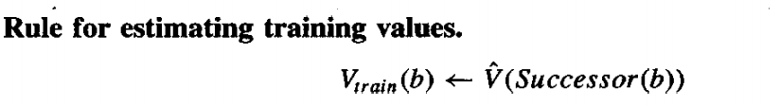
ESTIMATING TRAINING VALUES
one approach is to assign the training value of Vtrain(b) for any intermediate board state b to be V’(successor(b)), where V’ is the learner's current approximation to V and where Successor(b) denotes the next board state following b for which it is again the program's turn to move (i.e., the board state following the program's move and the opponent's response).
This rule for estimating training values can be summarized as

Slide 35
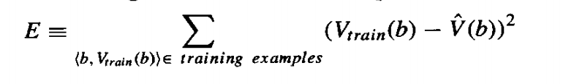
ADJUSTING THE WEIGHTS
It is reuired to specify the learning algorithm for choosing the weights wi to best fit the set of training examples {<b, Vtrain(b)>}
One common approach is to define the best hypothesis, or set of weights, as that which minimizes the square error E between the training values and the values predicted by the hypothesis V’.

Slide 36
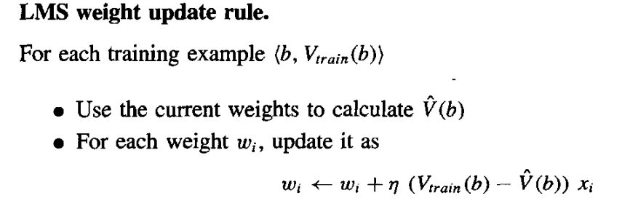
LMS training rule

Slide 37
Here ᶯ is a small constant (e.g., 0.1) that moderates the size of the weight update.
To get an intuitive understanding for why this weight update rule works, notice that when the error (Vtrain(b) – V’(b)) is zero, no weights are changed.
When (Vtrain(b) – V’(b)) is positive (i.e., when V’(b)) is too low), then each weight is increased in proportion to the value of its corresponding feature

Slide 38
The Final Design
The Performance System is the module that must solve the given performance task, in this case playing checkers, by using the learned target function(s). It takes an instance of a new problem (new game) as input and produces a trace of its solution (game history) as output. strategy used by the Performance System to select its next move at each step is determined by the learned V’ evaluation function
The Critic takes as input the history or trace of the game and produces as output a set of training examples of the target function.

Slide 39
The Generalizer takes as input the training examples and produces an output hypothesis that is its estimate of the target function.
The Experiment Generator takes as input the current hypothesis (currently learned function) and outputs a new problem (i.e., initial board state) for the Performance System to explore.

Slide 40
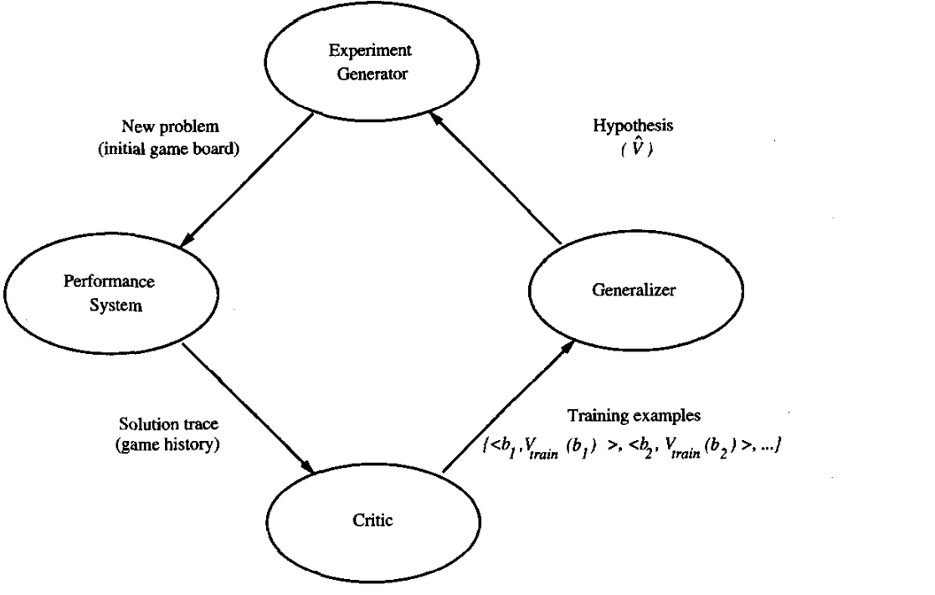
The Final Design

Slide 41
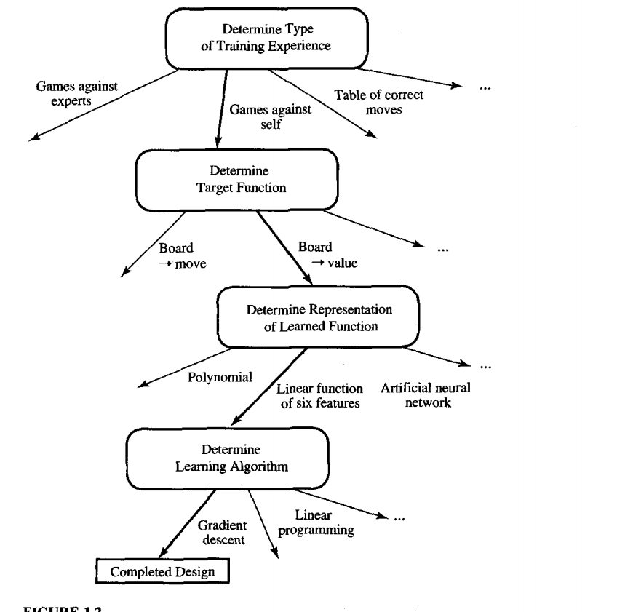
The sequence of design choices made for the checkers program is summarized in Fig

Slide 42
Issues in Machine Learning
What algorithms exist for learning general target functions from specific training examples? In what settings will particular algorithms converge to the desired function, given sufficient training data? Which algorithms perform best for which types of problems and representations?
How much training data is sufficient? What general bounds can be found to relate the confidence in learned hypotheses to the amount of training experience and the character of the learner's hypothesis space?
When and how can prior knowledge held by the learner guide the process of generalizing from examples? Can prior knowledge be helpful even when it is only approximately correct?

Slide 43
What is the best strategy for choosing a useful next training experience, and how does the choice of this strategy alter the complexity of the learning problem?
What is the best way to reduce the learning task to one or more function approximation problems? Put another way, what specific functions should the system attempt to learn? Can this process itself be automated?
How can the learner automatically alter its representation to improve its ability to represent and learn the target function?

